Slide 1
JDS-2
Java Design Studio - 2
Instructor
Ryan Liu
dio.ryanliu@Hotmail.com

Slide 2
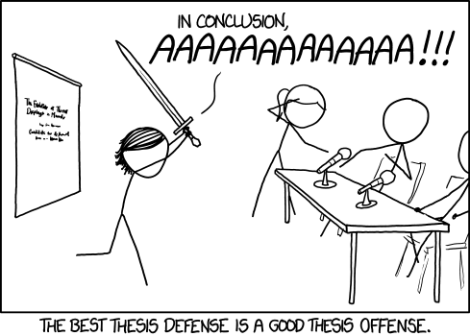
Homework
5 Problems of “easy” difficulty
Project Proposal
Notes:
5 problems of difficulty “easy” from https://leetcode.com/problemset/all/
Project Proposal must contain:
What the project is about (if it’s a game, what the game is)
Details of the project (what it does, what features it has, etc)
Project Goals (By week 2, Feature 1 will be done, etc)

Slide 3

Design Example
Notes:
What choices did the designer make when they designed the Richmond Oval?

Slide 4
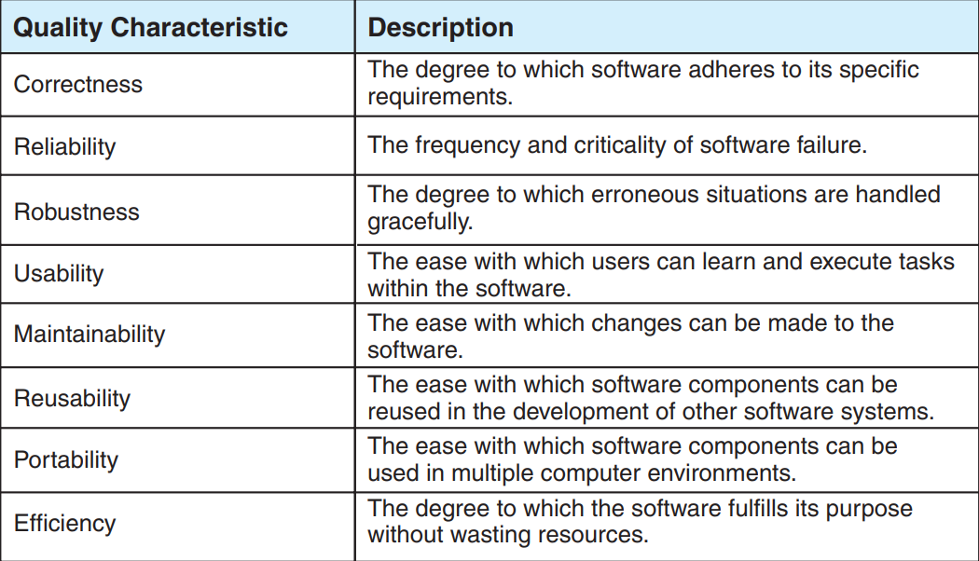
Sofware Design
What is Software Design?
Requirements vs Design?
“Software Quality”
Notes:
Requirements: What the system will do
Design: how the system will do it
Two ways to view a program – the user and the developer
Last class we talked about architecture and structure with components. How should one view the individual components in the two views?
Software quality is plays a huge part in design as it is the reflection

Slide 5
Sofware Design
How do we realize the product?
Focus on technical view
Requirements, Constraints, Input, Output
Ex. Bike
Notes:
Requirements: Functional and Non-functional (accessibility, cost, capacity, etc)
Constraints: Technical and non-technical
Input include the requirements
Output: what is produced?

Slide 6
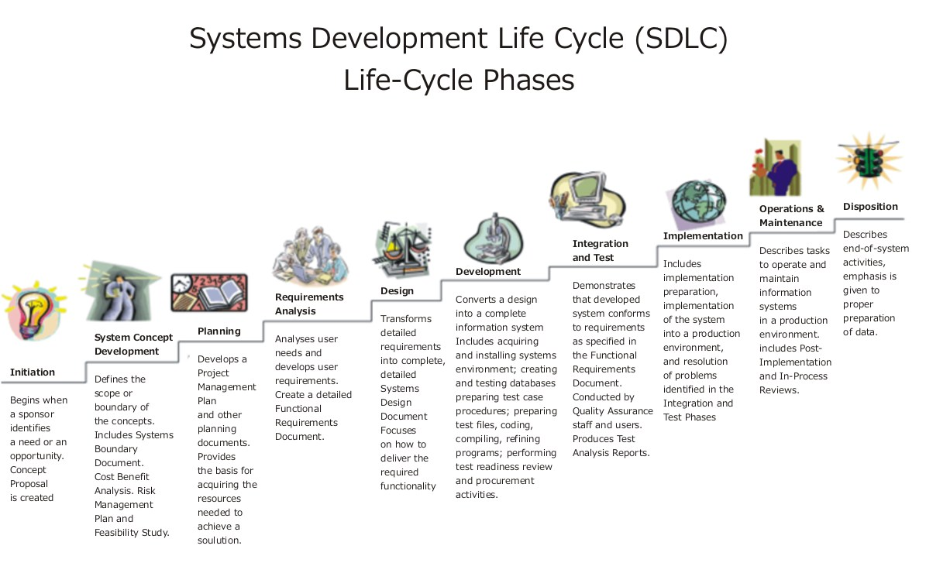

Slide 7
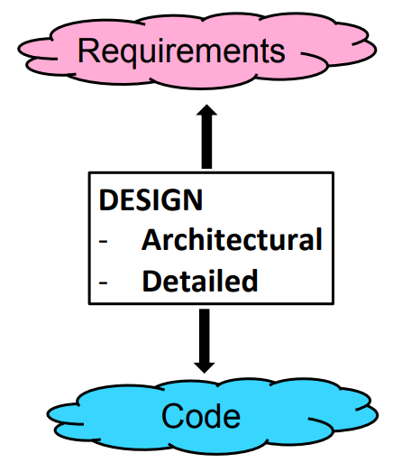
Phase Gap
Connects Requirements and Constraints to actual Code
Why is this important?
Notes:
Ask about importance of design
Facilitates communication Eases system understanding Eases implementation Helps discover problems early Increases product quality Reduces maintenance costs Facilitates product upgrade

Slide 8
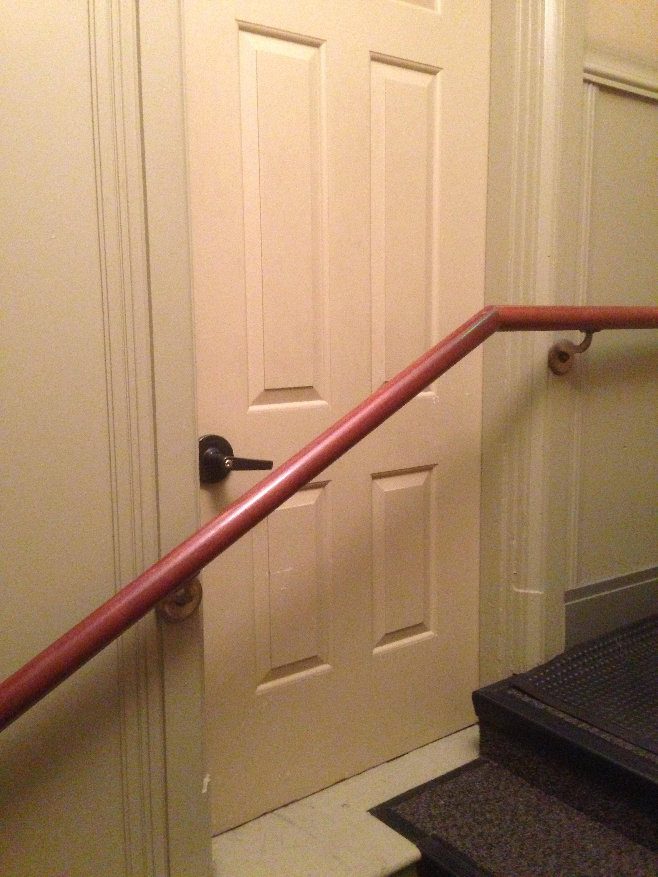
?

Slide 9
Activity
Come up with the overall design of a mug
Include Requirements, Constraints, Input and Output

